Slide 1
STATIC TECHNIQUES
Presentation by
Jithu K

Slide 2
Introduction
Static Testing
Different types of Reviews
Static Analysis
Static Analysis by Tools

Slide 3
Test Design Techniques
Method of designing a Test
Ensuring system is working as expected
Two types
Static
Without Executing the code
Dynamic
By Executing the code

Slide 4
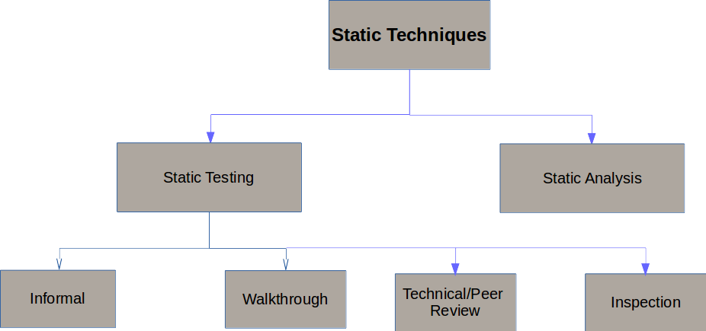

Slide 5
What is Static Testing?
To provide a great way to improve the quality and productivity of software development
By assisting engineers to recognize and fix their own defects early in the development process.
Starts early in the Life cycle and so it is done during the verification process.
Examines Work documents like:
Requirement specifications
Design document
Source Code
Test Plans
Test Cases
Test Scripts
Help or User document

Slide 6
Uses of Static Testing
As the defects are getting detected at an early stage so the rework cost most often relatively low.
Development productivity is likely to increase because of the less rework effort.
Types of the defects that are easier to find during the static testing are:
Deviation from standards
Missing requirements
Design defects
Non-maintainable code
Inconsistent interface specifications.

Slide 7
Informal Review
Conducted on an as-needed I.e. Informal agenda
The date and the time of the agenda for the Informal Review will not be addressed in the Project Plan
The developer chooses a review panel and provides and/or presents the material to be reviewed
The material may be as informal as a computer listing or hand-written documentation

Slide 8
Formal Review
Conducted at the end of each lifecycle phase I.e. Formal Agenda
The agenda for the formal review must be addressed in the Project Plan
The material must be well prepared.
Eg:
Software Requirements Review
Software Preliminary Design Review
Software Critical Design Review
Software Test Readiness Review.

Slide 9
Roles and Responsibilities
The reviewers:
Also known as checkers or inspectors
Check any material for defects, mostly prior to the meeting
The manager can also be involved in the review depending on his or her background.
The managers:
Manager decides on the execution of reviews
Allocates time in project schedules and determines whether review process objectives have been met
The moderator:
Also known as review leader
Performs entry check
Follow-up on the rework
Schedules the meeting
Coaches other team
Leads the possible discussion and stores the data that is collected
The author
Illuminate the unclear areas and understand the defects found
Basic goal should be to learn as much as possible with regard to improving the quality of the document.
The scribe:
Scribe is a separate person to do the logging of the defects found during the review.

Slide 10
Formal Review Process
A formal review process consists of six main steps:
Planning
>Selecting the personnel, allocating roles, defining the entry and exit criteria for more formal review types (e.g. inspection), and selecting which parts of documents to look at.
Kick-off
>Distributing documents, explaining the objectives, process and documents to the participants, checking entry criteria (for more formal review types).
Preparation
>Work done by each of the participants on their own before the review meeting, noting potential defects, questions and comments.
Review meeting
>Discussion or logging, with documented results or minutes (for more formal review types). The meeting participants may simply note defects, make recommendations for handling the defects, or make decisions about the defects.
Rework
>Fixing defects found, typically done by the author.
Follow-up
>Checking that defects have been addressed, gathering metrics and checking on exit criteria

Slide 11
Different type of Reviews
Walkthrough
It is not a formal process
It is led by the authors
Author guide the participants through the document according to his or her thought process to achieve a common understanding and to gather feedback.
Useful for the people if they are not from the software discipline, who are not used to or cannot easily understand software development process.
Is especially useful for higher level documents like requirement specification, etc.
The goals of a walkthrough:
To present the documents both within and outside the software discipline in order to gather the information regarding the topic under documentation.
To explain or do the knowledge transfer and evaluate the contents of the document
To achieve a common understanding and to gather feedback.
To examine and discuss the validity of the proposed solutions

Slide 12
Technical review:
It is less formal review
It is led by the trained moderator but can also be led by a technical expert
It is often performed as a peer review without management participation
Defects are found by the experts (such as architects, designers, key users) who focus on the content of the document.
In practice, technical reviews vary from quite informal to very formal
The goals of the technical review are:
To ensure that an early stage the technical concepts are used correctly
To access the value of technical concepts and alternatives in the product
To have consistency in the use and representation of technical concepts
To inform participants about the technical content of the document

Slide 13
Inspection:
It is the most formal review type
It is led by the trained moderators
During inspection the documents are prepared and checked thoroughly by the reviewers before the meeting
It involves peers to examine the product
A separate preparation is carried out during which the product is examined and the defects are found
The defects found are documented in a logging list or issue log
A formal follow-up is carried out by the moderator applying exit criteria
The goals of inspection are:
It helps the author to improve the quality of the document under inspection
It removes defects efficiently and as early as possible
It improve product quality
It create common understanding by exchanging information
It learn from defects found and prevent the occurrence of similar defects

Slide 14
What is static analysis?
Method of computer program debugging that is done by examining the code without executing the program.
Process provides an understanding of the code structure, and can help to ensure that the code adheres to industry standards.
Benefits of Static Analysis
Early detection of defects prior to test execution.
Early warning about suspicious aspects of the code or design, by the calculation of metrics, such as a high complexity measure.
Identification of defects not easily found by dynamic testing.
Detecting dependencies and inconsistencies in software models, such as links.
Improved maintainability of code and design.
Prevention of defects, if lessons are learned in development.

Slide 15
Typical defects discovered by static analysis tools
Referencing a variable with an undefined value
Inconsistent interface between modules and components
Variables that are never used
Unreachable (dead) code
Programming standards violations
Security vulnerabilities
Syntax violations of code and software models.

Slide 16
Thank You!

